Slide 1
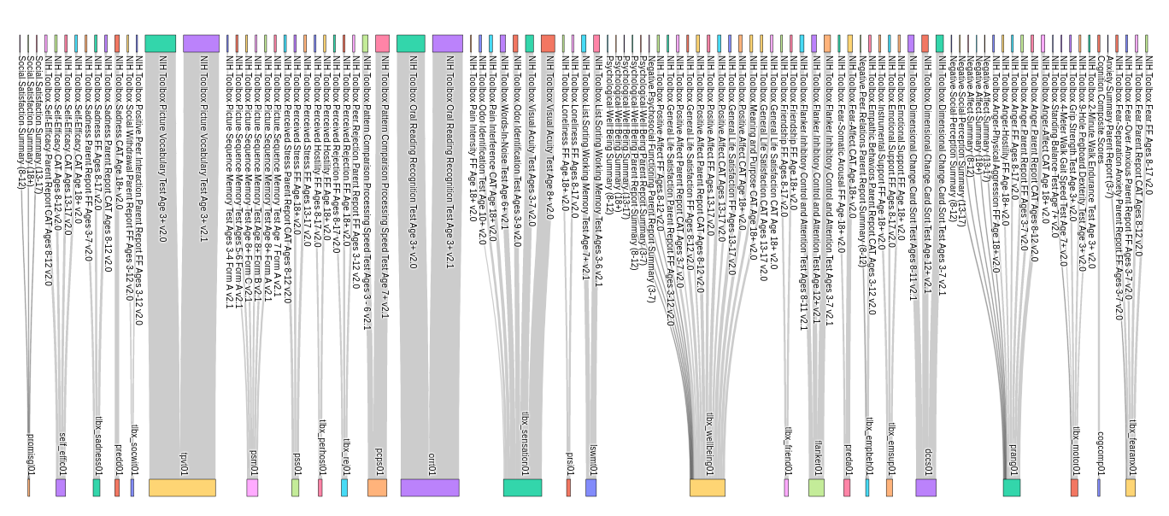
Mission: Place data organized by Instruments in the NIH Toolbox ipad output (top) into structures at the NDA (bottom) while
preserving instrument/version/Assessment etc

Slide 2
Harmonization: map between source and destination locations, based on data dictionaries from the two universes Simplest case: one row per person per visit in both universes – mapping is one to one; nothing else to consider NIH TOOLBOX Case: three files of different dimensionality per person, per versioned ‘instrument’ going to structures with different dimensionality grouped by domain and/or size of battery

Slide 3
What do the NIH Toolbox Data Look like coming off the iPAD?
Each subject/visit is associated with data in three files
Registration
‘Data’ files (item level responses)
Scores file (summary statistics calculated by the IPAD software on these item level responses and/or across instruments)
ID/key linking these files = ‘PIN’ variable and ‘Inst’ (Instrument).
ex). HCA1234567_V1, HCD2222222_V2, ‘NIH Toolbox Visual Acuity Test Age 8+ v2.0’

Slide 4
‘Scores’ files
Every row in the file represents a score for a particular ‘instrument’ or (as for composite scores) score across instruments
Subjects complete instruments depending on age, protocol, typos…etc. Roughly 40 unique instruments per person are completed for Lifespan subjects.
The union of all unique instruments completed is ~120 over the Lifespan Studies (HCP-A and HCP-D) due to protocol differences by age, gender, etc.

Slide 5
‘Scores’ files
Every row in the file represents a particular ‘instrument’ or behavioral data battery that a subject has completed , or (as for composite scores) score across instruments.
Which instruments a subject completes depends on age, protocol, typos…etc. Roughly 40 unique instruments per person are completed.
The union of all unique instruments completed is ~120 over the Lifespan Studies (HCP-A and HCP-D)

Slide 6
Raw or ‘Data’ files, example
Every row represents an event on the IPAD.
For example 20 questions for a given instrument would be 20 rows in the raw/data files, which were then summarized as a single row in the scores file (sum of all 20 entries, for example).
~40 instruments x 10 events per instruments (ball park), per person.
Key variable to merge with scores file for NDA data dictionary: ItemID
By PIN and Inst

Slide 7
Problem 1 -- > Solution
NIH TOOLBOX Ipad exports received as raw, scored, and registration data files, but NDA has just one destination row for each instrument. Need to link this information together into single record
→Pivot (transpose) score of each item into single row (with ItemID as variable name) to merge with scored data before transforming to NDA universe. Now you have one row per person per instrument per timepoint of data coming from the (reduced) NIH Toolbox IPAD output data

Slide 8
Now that you have the data in the same dimensions, you can think about the one-to-one mapping of variables

Slide 9
Complete List of CROSSWALK COLUMNS for NIH TOOLBOX DATA TYPES necessary for mapping between SYSTEMS
Column in the Crosswalk | Annotation Source | Description
validated | HCP | Indicator, if 'NO' means the code will skip this instrument because the Instrument hasn't yet been fully fleshed out (at the NDA), doesn't have complete documentation (NIH Toolbox Data dictionary incomplete) or is otherwise un-validated
Measurement System | NIH Toolbox Data Dictionary | NIH Toolbox, Promis, Neuro-QOL, Sci-QOL SCI-FI TBI-QOL
Domain | NIH Toolbox Data Dictionary | Sensation, Cognition, Motor, Emotion
Inst | NIH Toolbox Data Dictionary | where applicable: NIH Toolbox Instrument Name - e.g. the contents of 'Inst'
Item ID | NIH Toolbox Data Dictionary | Name of variable in the NIH Toolbox (has special characters that needed stripping)
Stem | NIH Toolbox Data Dictionary | not located
Context | NIH Toolbox Data Dictionary | not located
DataType | NIH Toolbox Data Dictionary | not located
Responses | NIH Toolbox Data Dictionary | Values observed in exported data ‘Response’ column (with exceptions). Note that the score for these responses (e.g. correct/incorrect) is in the Score column. Often, the response column and the score column are the same, but not always
Source | HCP | HCPA or HCPD – housekeeping variable useful for keeping track during Crosswalk building process
hcp_variable | HCP | Name of the Variable being mapped, as it exists in HCP data ready for crossing over
requested_python | HCP | Python code to handle Form Requests, unless specialty code required
specialty_code | HCP | Indicator for when data needs to be reshaped (change in data vector unit) and specialty code is needed.
hcp_variable_upload | HCP | HCP renaming to NDA elements locally to keep track of mapping. This should be exactly the same as nda_element
nda_structure | NDA - Data Dictionary | Short name of NDA Structure to which our data is mapped
nda_element | NDA - Data Dictionary | NDA element
description | NDA - Data Dictionary | NDA element description
valueRange | NDA - Data Dictionary | NDA value Range
notes | NDA - Data Dictionary | NDA notes
action_requested | NDA -Curator | Requests that NDA made of CCF to avoid naming conflicts, or value codings, etc.
template | NDA -Curator | name of NDA template provided by Leo for crossover mapping -
inst_short | NDA -Curator | where applicable: NDAs shorthand for NIH Toolbox Instrument name of the Zip folder (usually)- this is NOT NDAs name for any particular structure – it is merely a housekeeping variable used in crossover mapping.
structure_label | needed | Long name of structure

Slide 10
Complete List of CROSSWALK COLUMNS for NIH TOOLBOX DATA TYPES necessary for mapping between SYSTEMS
Column in the Crosswalk | Annotation Source | Description
validated | HCP | Indicator, if 'NO' means the code will skip this instrument because the Instrument hasn't yet been fully fleshed out (at the NDA), doesn't have complete documentation (NIH Toolbox Data dictionary incomplete) or is otherwise un-validated
Measurement System | NIH Toolbox Data Dictionary | NIH Toolbox, Promis, Neuro-QOL, Sci-QOL SCI-FI TBI-QOL
Domain | NIH Toolbox Data Dictionary | Sensation, Cognition, Motor, Emotion
Inst | NIH Toolbox Data Dictionary | where applicable: NIH Toolbox Instrument Name - e.g. the contents of 'Inst'
Item ID | NIH Toolbox Data Dictionary | Name of variable in the NIH Toolbox (has special characters that needed stripping)
Stem | NIH Toolbox Data Dictionary | not located
Context | NIH Toolbox Data Dictionary | not located
DataType | NIH Toolbox Data Dictionary | not located
Responses | NIH Toolbox Data Dictionary | Values observed in exported data ‘Response’ column (with exceptions). Note that the score for these responses (e.g. correct/incorrect) is in the Score column. Often, the response column and the score column are the same, but not always
Source | HCP | HCPA or HCPD – housekeeping variable useful for keeping track during Crosswalk building process
hcp_variable | HCP | Name of the Variable being mapped, as it exists in HCP data ready for crossing over
requested_python | HCP | Python code to handle Form Requests, unless specialty code required
specialty_code | HCP | Indicator for when data needs to be reshaped (change in data vector unit) and specialty code is needed.
hcp_variable_upload | HCP | HCP renaming to NDA elements locally to keep track of mapping. This should be exactly the same as nda_element
nda_structure | NDA - Data Dictionary | Short name of NDA Structure to which our data is mapped
nda_element | NDA - Data Dictionary | NDA element
description | NDA - Data Dictionary | NDA element description
valueRange | NDA - Data Dictionary | NDA value Range
notes | NDA - Data Dictionary | NDA notes
action_requested | NDA -Curator | Requests that NDA made of CCF to avoid naming conflicts, or value codings, etc.
template | NDA -Curator | name of NDA template provided by Leo for crossover mapping -
inst_short | NDA -Curator | where applicable: NDAs shorthand for NIH Toolbox Instrument name of the Zip folder (usually)- this is NOT NDAs name for any particular structure – it is merely a housekeeping variable used in crossover mapping.
structure_label | needed | Long name of structure
LINKING INFORMATION PROVIDED BY THE NDA

Slide 11
More information about the NIH TOOLBOX ipad export data dictionary and a programmatic start to working with it:
https://nihtoolbox.force.com/s/article/data-dictionary https://nihtoolbox.force.com/s/article/definition-of-columns-in-the-ipad-app-exports https://github.com/humanconnectome/NIHToolbox2NDA/blob/master/Grab_NIH_Toolbox_Data_Dictionary_Annotation.ipynb
More information about the NDA Data Dictionary and a programmatic start to working with it:
https://nda.nih.gov/general-query.html?q=query=data-structure%20~and~%20orderBy=shortName%20~and~%20orderDirection=Ascending
Https://github.com/humanconnectome/NIHToolbox2NDA/blob/master/Grab_NDA_Data_Dictionary_Annotation.ipynb

Slide 12
Problem 2:
NDA has mixture of ways in which to handle the merging of instruments from the NIH Toolbox

Slide 13
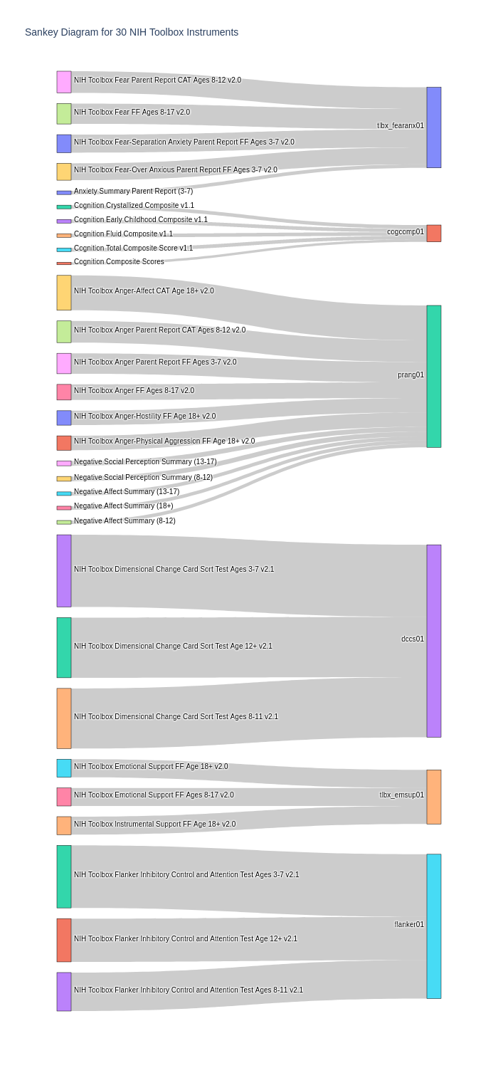
Non-universal solutions NOT ADOPTED:
One row per person/visit/Instrument/Assessment (in version column i.e. flanker)
One row per person/visit (Instrument-Assessment x 4 in version column - cogcomp01 )
One row per person/visit/Instrument/proxy (has parents and summary scores Prang)
Scores within instruments vs scores across instruments vs mutually exclusive scores due to age-specific instrument versions

Slide 14
Solution
→ Explicitly specify the following variables for each Instrument, so that when they get stacked into the same structure, they are programmatically distinguishable down the road, regardless of whether the data in their ‘rawscores’ variables were mapped to the same or different elements within the NDA structure:
string contained by ‘Inst’ from the app to map to ‘version_form’
‘Assessment Name’ mapped to ‘fneproc ‘ (usually 1 or 2 in our data, but can hold string up to 20 characters)
HCP created variable, ‘respondent’ mapped to ‘compqother’

Slide 15
NDA Destination File (for the NIH Toolbox Friendship FF Age 18+ 2.0 instrument) looks like this when it is uploaded
tlbx_friend01 is the name of the structure in the NDA– when downloading a structure from the NDA, you’ll get all of the ‘instruments’ that were mapped to this same structure IN TERMS OF ELEMENT NAMES (not aliases). If you are a whiz with the API, perhaps you can extend its functionality to quickly see where things got mapped for other studies by following the alias trail.

Slide 16
NDA Destination File (for the NIH Toolbox Friendship FF Age 18+ 2.0 instrument) looks like this when it is uploaded
Version_form, compqother, and fneproc for Instrument Name, respondent (self or parent), and Assessment Name

Slide 17
NDA Destination File (for the NIH Toolbox Friendship FF Age 18+ 2.0 instrument) looks like this when it is uploaded
Columns populated from the Scores file output of the IPAD app
Columns required in every structure: subjectkey, src_subject_id, interview_age, gender

Slide 18
NDA Destination File (for the NIH Toolbox Friendship FF Age 18+ 2.0 instrument) looks like this when it is uploaded
ItemID
Score Column from Raw data for this instrument pivoted into a row for each person

Slide 19
SO HOW DO YOU DO THIS for your data?
Go to README.md for a general overview of steps
https://github.com/humanconnectome/NIHToolbox2NDA/blob/master/README.md

